Slide 1
Tether – A De-orbiting Mechanism
By :
Manu Srivastava
Kartik Patekar

Slide 2
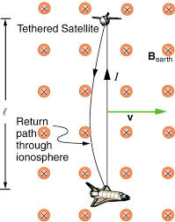


Basic Physics
A motional Electromotive Force (EMF) is generated across a tether element, as it moves relative to a magnetic field.
This EMF can be used by the tether system to drive the current through the tether which would cause the tether to experience a force that can accelerate it.
This can be exploited to lower the orbit of the satellite .

Slide 3
Electron emitter
Electron emitters help to complete the circuit through the plasma .
Its types:
i) Thermionic
ii) Hollow Cathode
iii) Field Emitting Arrays
Electron gun is needed in addition to push the electrons away from the tether so that its potential doesn’t become too negative.

Slide 4
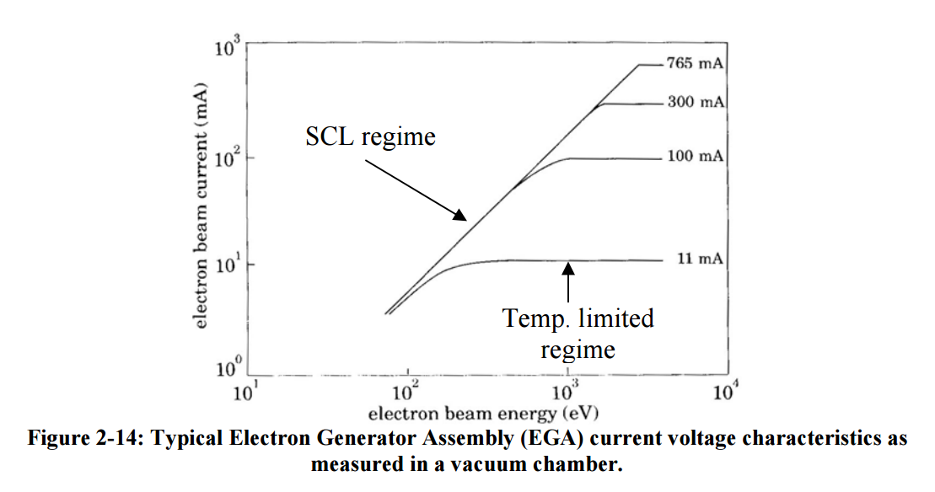
Thermionic Emitters
Once the electrons are thermionically emitted from the TC surface they require an acceleration potential to cross a gap, or in this case, the plasma sheath.

Slide 5
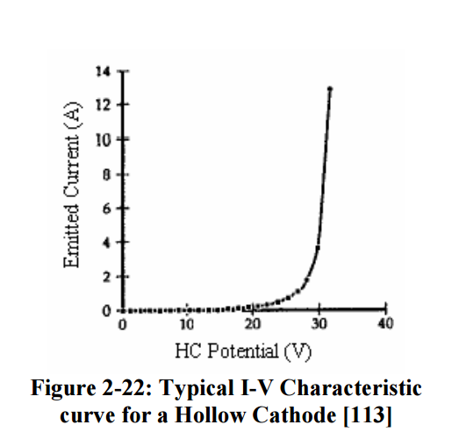
Hollow Cathode Emitters
Hollow cathodes emits a dense cloud of plasma by first ionizing a gas. This creates a high density plasma plume which makes contact with the surrounding plasma.
A noble gas flows into the insert region of the HC and is partially ionized by the emitted electrons that are accelerated by an electric field

Slide 6
FEA

Slide 7
Electron Collecter

Slide 8
Material Specification
: The choice of the metal conductor to be used in a space tether is determined by a combination of low resistivity (high conductivity) and low density, with cost, strength, and melting point as secondary considerations for certain applications.
Aluminum has a resistivity r=27.4 nΩ-m, which is significantly greater than that of copper, but it has a much lower density of d=2700 kg/m3 . It is presently the best candidate.
. An alternate candidate material would be beryllium. . Unfortunately, despite decades of metallurgical research by the nuclear power industry, highly ductile alloys of beryllium have not been found,

Slide 9
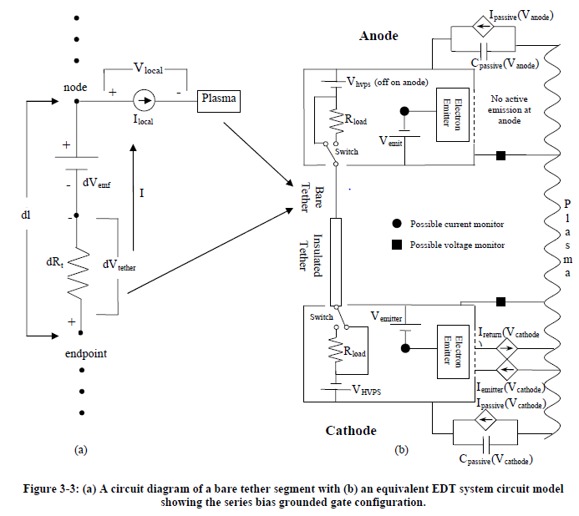
Circuit Diagram

Slide 10

KVL & KCL Equations

